Slide 1

Good Documentation Practices for Oncology Clinical Research
ALCOA+ Principles
Authored by the 2023 AACI CRI Education and Operations Subcommittee

Slide 2
What is Source Documentation?
Source documentation is information contained in original records (where the information is first recorded) and/or certified copies of original records.
Source documentation for clinical research:
  confirms eligibility for the participant for the clinical research study/trial;
  documents the progress of the participant during the study/trial; and
  forms the foundation for the data submitted to the trial sponsor, primarily via Clinical Research Forms (CRFs) completed via an electronic database, which is used to share results of the research.
Source documents includes clinical findings, observations, accountability of investigational agent(s) as applicable, and other activities in a clinical trial necessary for the reconstruction and evaluation of the trial.

Slide 3
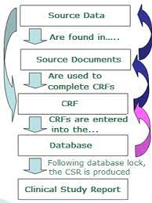
Source Documentation vs. Source Data
Source data are contained in source documents (original records or certified copies). Source documents are where data regarding study subjects are first recorded and are the basis for information submitted to the trial sponsor on case report forms.

Slide 4
Basics of Source Documentation
Most source documentation is found in the electronic medical record (EMR) for a research participant. Source documentation may also be paper (wet-ink signed consent form, drug dairies, and participant surveys) and electronic documents outside of the medical record (eConsent, electronic participant survey, and email correspondence).
Source documentation helps show that research participants were treated according to the research protocols, and where deviations may have occurred. This is only possible with good documentation.
The ALCOA+ Principles are used in clinical research to ensure data integrity (see next slide for ALCOA definitions).

Slide 5
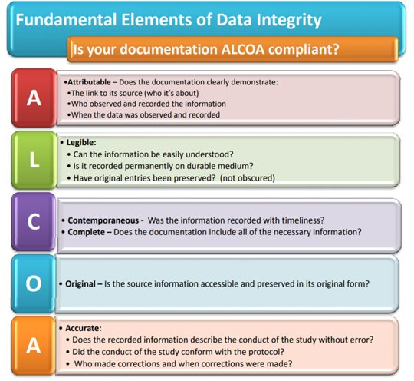
ALCOA+ Principles
Additional Elements of Data Integrity
What are the "pluses"?
C
Consistent – information is included every time
A
Available – information is readable at the appropriate time during and after the study for all who need it
Accessible – information is easy to find and view
E
Enduring – information is long-lasting and durable
Image reference: http://chadwickspencer.com/myblog/index.php/2018/05/04/data-integrity/

Slide 6
Attributable
It should be clear who has documented the data.
This means there should be a signature and date on all documentation. Every page.
If more than one person makes an entry on the same source document, each entry must be signed and dated.
If a record is changed, it should be clear who made the change.

Slide 7
Attributable
It is NOT clear who updated this source or when it was updated
It is clear who updated this source and the date

Slide 8
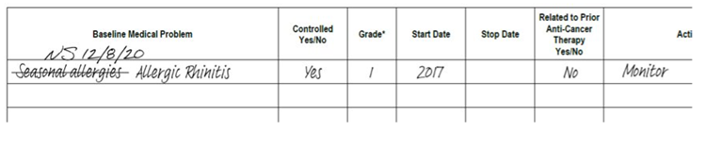
Legible
Information should be readable, and signatures should be identifiable
Good example:
Information should be easily understood. If handwritten, it should be legible and clear. All handwritten/paper forms should be completed in ink (blue or blank only).
To correct source documents, draw a line through the error, initial and date the change (even when a patient makes a change).
Entries into the medical record have been preserved and an audit trail is maintained during electronic documentation. All nursing notes, vitals, labs, drug administration, etc., should be recorded in the electronic medical record.
Example:

Slide 9


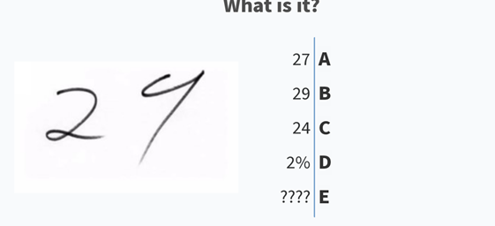

Legible
Examples of bad legibility:
Handwritten notes use acronyms and/or slang and are written in illegible handwriting with pencil or red pen.
If correcting a source document, it is missing initials/dates and there is white-out, write overs, erasing, scribbling/obliterating, or tearing of the incorrect portion used.
Examples:

Slide 10
Contemporaneous
Data, observations, and activities are recorded in a timely manner.
Good examples:
  An email exchange that shows that the PI was made aware of an SAE (as source documentation) and includes a timestamp (with the correct time zone) on the emails.
  The PI signs off on the SAE within 24 hours after having knowledge of it.
Bad examples:
  The study coordinator informed the PI of an SAE two days after becoming aware of it.
  The weekly tracker entries were recorded two weeks after the patient visit, which can lead to inaccurate data (especially if the study coordinator cannot fully recall details from the patient visit).

Slide 11
Consistent
Information is included every time.
Good example:
    The dates of the study patients’ visits are in chronological order in the weekly trackers and follow a time sequence.
Bad example:
    The dates of the study patients’ visits in the weekly tracker are not in chronological order and do not follow a time sequence. For example, an entry in the weekly tracker has a study visit date of 2/20/23, but the following entry has a study visit date of 1/12/23.

Slide 12
Complete
All data is present (no omissions, no deletions) and includes initial data, meta-data, etc.
Good examples:
    The study coordinator checks the patient’s records prior to the visit to ensure that the patient’s vitals have been consistently recorded.
    The study coordinator/research nurse fills out the research sheet with complete and thorough details regarding how the EKGs should be done.
Bad examples:
    Data points are missing because the study patient’s vitals were not consistently taken at each visit.
    The study coordinator/research nurse fills out the research sheet, leaving out complete and thorough details regarding how the EKGs should be done. This can result in not having all the required data.

Slide 13
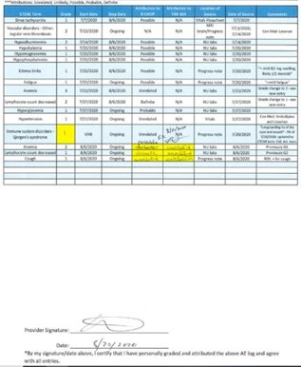
Contemporaneous Consistent
Complete
Example:
Each line is a timely recorded activity, in sequence
Signed and Dated

Slide 14
Original
Information is viewed in its first format (e.g., electronic, paper)
Good examples:
  Source information is accessible and preserved in its original form. Source documentation is where the information is first recorded. For some types of source documents, it is appropriate to make copies in order to help preserve the integrity of the original document.
  Electronic medical records are not printed, they are always accessed electronically
  Paper records are promptly uploaded as files that cannot be modified or altered. They are also uploaded in electronic systems, such as an electronic regulatory binder, the EDC, Box, etc.

Slide 15
Original
Bad examples:
  No source documentation to accompany an item/procedure on the eligibility checklist. Original documents were destroyed or discarded.
  Modifications were made to paper records without indicating that it was an update, leading to mistaking it for an original record
  Paper documents are destroyed during the life of a study

Slide 16
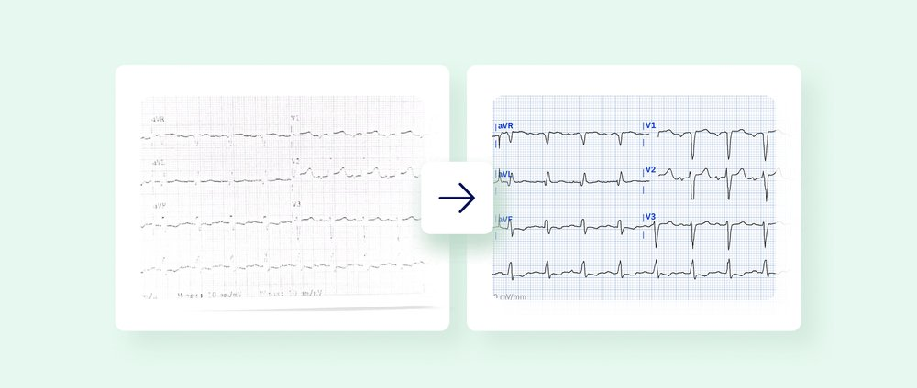
Original
  Example: Original EKGs are printed on heat-sensitive paper that fades over time. These should be copied after being reviewed by an investigator.

Slide 17
Accurate
Consistent, error free, and real representation of facts
Necessary as a basis for decision-making
Good examples:
  The recorded information describes the conduct of the study without error. Research documentation should represent what ACTUALLY happened. Corrections should be made using standard correction practices. If protocol-required procedures were missed or completed incorrectly, a protocol deviation should be completed in real time.
    Example: A research nurse is about to weigh the patient and checks to make sure that the scale is properly calibrated.
    Example: A research nurse consistently uses the clock on their phone to document the time of PK draws and avoids using the wall clock.
    Example: A study participant calls the research nurse to inform them they cannot make their scheduled appointment due to inclement weather; the research nurse documents the call and adds the deviation to the deviation log.

Slide 18
Accurate
Bad examples:
  Errors in medical record documentation were corrected on a printed document and then scanned in.
    Example: Physician notes and nursing notes have discrepant information and missing source documentation. Discrepant information can result in incorrect data entry and may generate unnecessary queries.
    Example: A research nurse took a study patient’s vitals and recorded the values by rounding to the tenths place (one decimal place) instead of recording the values with two decimal places (according to the protocol).
    Example: Consecutive physician notes contain the same sentence about an adverse event that appears to be copied from a previous note, so it is unclear whether the event is ongoing, or the sentence was carried forward in error.

Slide 19
Available
Accessible
Good example:
  Data can be accessible for review, audit, or inspection over the lifetime of the record, including after the contract ends.
    Example: Data and source documents are all available, including original versions of informed consent forms that were later modified (reconsent).
Bad example:
  The original informed consent forms were deleted/removed/overwritten after a reconsent was issued to the study patients.
    Example: The original informed consent is not available to access or review due to being deleted, or removed, or overwritten.

Slide 20
Enduring
Good example:
  Documentation is available throughout the study and during the required time after study completion.
  For Investigational New Drug (IND) research, the Food and Drug Administration (FDA) requires that sponsors and investigators retain “records and reports required by this part for 2 years after a marketing application is approved for the drug; or if an application is not approved for the drug, until 2 years after shipment and delivery of the drug for investigational use is discontinued, and the FDA so notified.”
  Many institutions have a minimum time period for keeping records. In addition, many research agreements with sponsors will include a minimum time period for record retention.
    Example: Th study patient’s MRIs are stored on CDs.

Slide 21
Enduring
Bad example:
  Documentation is not kept in a format amenable for long-term storage. Not planning how to store and access paper documents long-term and using databases without an archive plan. Documentation is discarded before the time period required by applicable FDA guidelines, institutional practice, or sponsor agreement, whichever is longest.
    Example: The study patient’s MRI is stored in an unauthorized USB drive.

Slide 22

Assessment Questions

Slide 23
Match the ALCOA+ Terms with Their Definitions
Legible _____
Original _____
Attributable _____
Enduring _____
Contemporaneous _____
Consistent _____
Available/Accessible _____
Accurate _____
Complete _____
It should be clear who has documented data
Long-lasting and durable
Readable with identifiable signatures
Information is easy to find, view, and access at the appropriate time during and after the study
Recorded in a timely manner
Consistent, error-free and real representation of facts and
All necessary information is included
Information is viewed in the its first format
All necessary information is included every time

Slide 24
Additional suggestions for testing understanding
Create additional examples of things that are not ALCOA+ and ask questions such as: “What is/are the missing piece(s)?", “How do you make it ALCOA+ compliant?", “Why is it not ALCOA+ compliant?", etc.
Examples:
  Legible – GCP corrected without initials and date, or initialed but forgot date
  Wrote encounter note a month after encounter occurred
  Enduring/Original: Lines will fade on EKG/thermal paper and a copy must be made

Slide 25

Citations and Additional Resources
(PDF) Good documentation practice in clinical research (researchgate.net)
Include any other links that may be useful
AACI thanks the CRI Education and Operations Subcommittee Good Documentations Working Group for authoring this guide.
For questions, please contact AACI Clinical Research Innovation (CRI) at cri@aaci-cancer.org

